Slide 1
Tensor Floyd
Music Hackathon

Slide 2
Technical environment
Music21
Keras
Numpy
Scipy
matplotlib

Slide 3
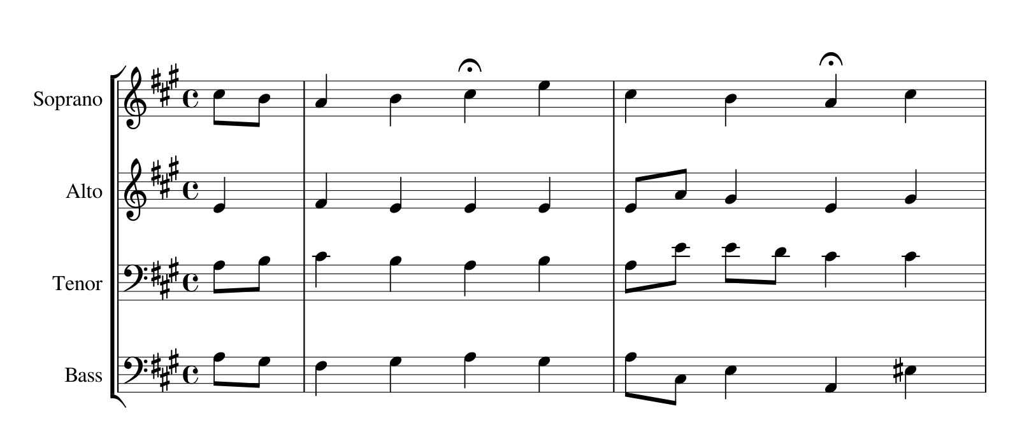
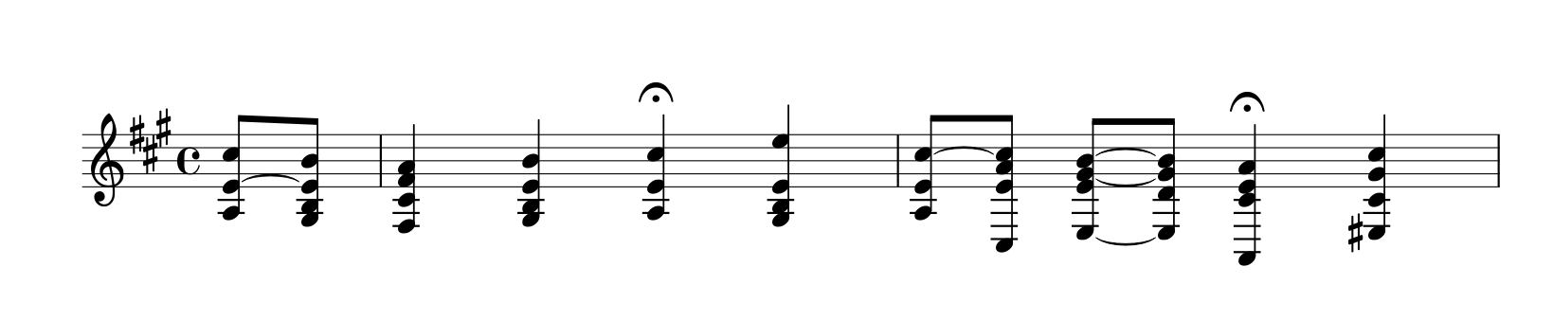

Music input selection
Music 21 corpus
Song selected for theme (classical : Bach, Beethoven, Vivaldi, Chopin, etc)
Same instrument tracks merged (chordification)

Slide 4
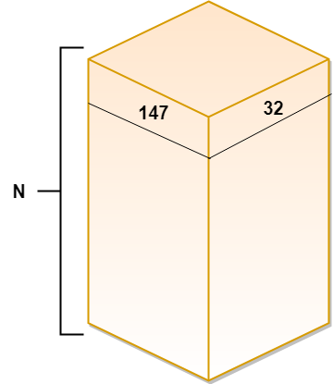
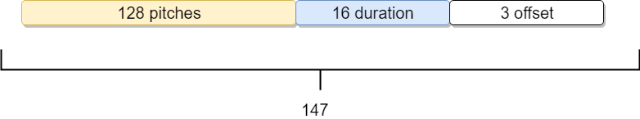
Data preprocessing
Data architecture
One hot encoding of chords
Discrete durations (capped at 16th )
Time offset (measure, group, song)

Slide 5
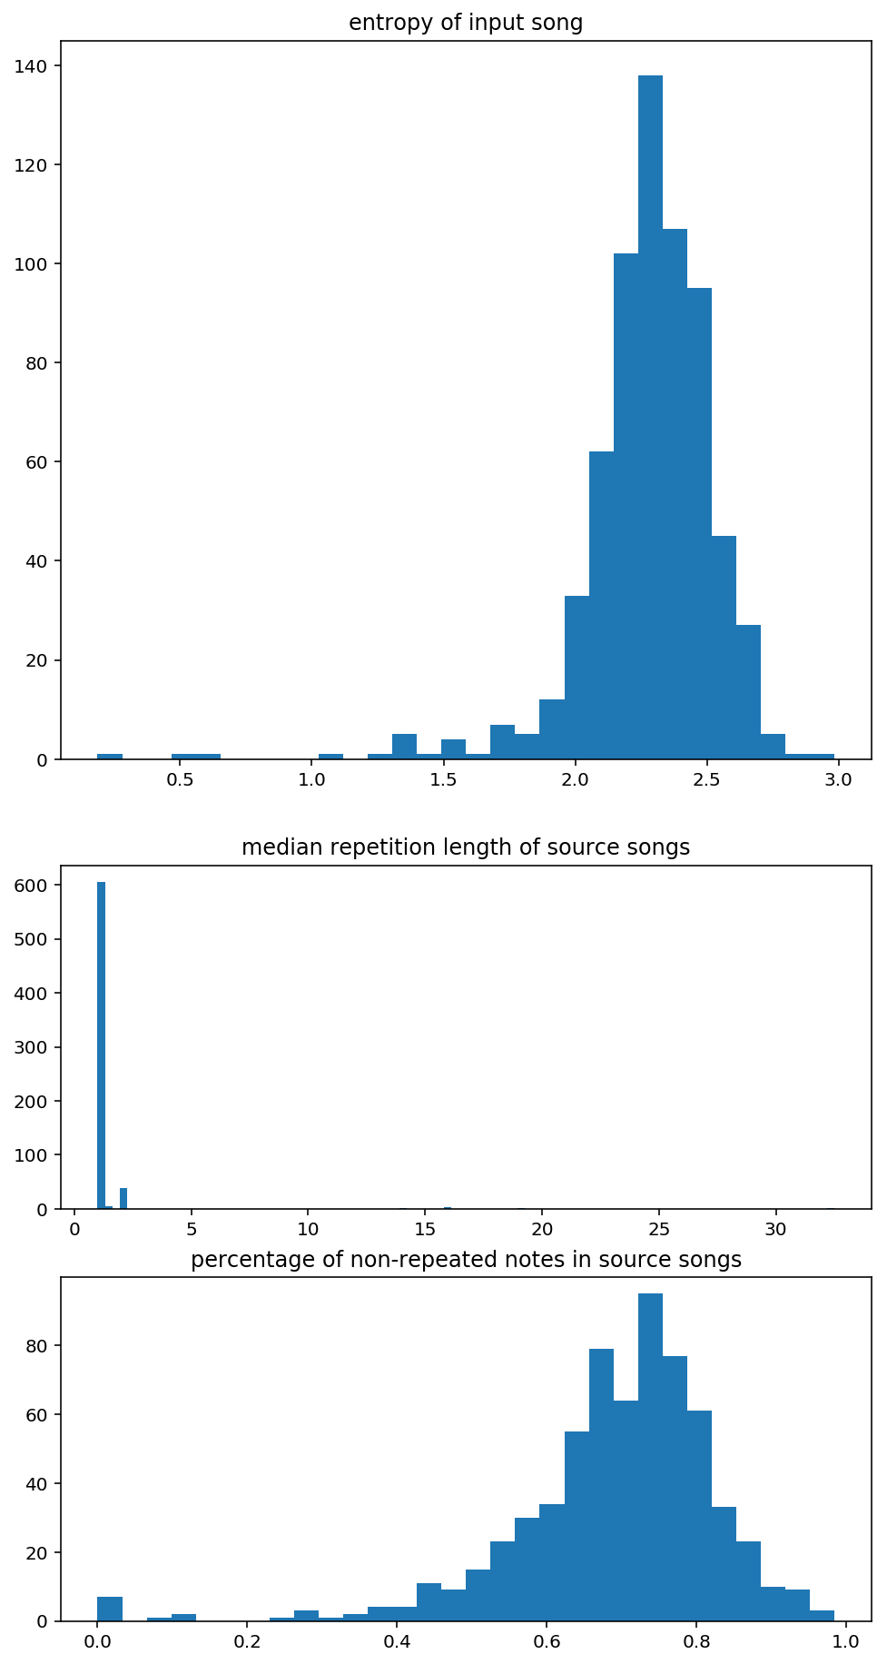
Evaluation metrics
Binary Cross Entropy loss
Entropy of notes (note diversity)
Median repetition length
Percentage of non-repeated notes
Tempo variations

Slide 6
Model architectures
Variational Autoencoder : converged to trivial repetition
Convolutional RNN 1 note prediction : good variance but dissonant chord progression
Convolutional RNN 32 note prediction : less dissonant chord progression
LSTM based 32 note prediction:

Slide 7
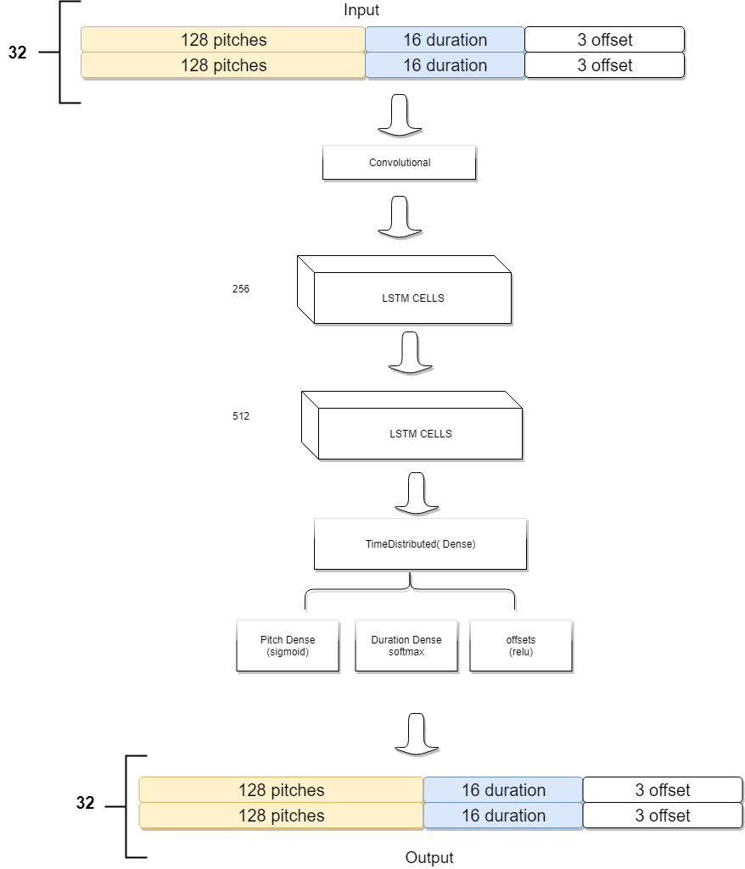
Architecture
Convolutional
LSTM
TimeDistributed (Dense)
Split

